Slide 1

HIWORLD
IOS Development
Wade li, feng yu(robby) zhang, Saurav KC

Slide 2

Look around!

Slide 3

Say “hi” ;)

Slide 4


Slide 5


“Hiworld”
Social app that is using your current geolocation, help you to find other users nearby and willing to make new friends!

Slide 6

table of contents
Overview
Product Spec
Wireframes

Slide 7


Overview
Description
Uses users’ current geolocation (under permission) find other users who’s open to conversations with strangers. could be potentially used as a dating app, or just meeting new friends nearby.

Slide 8
App Evaluation（1）
category: social networking / social communication
mobile: this app would be primarily developed for mobile but would perhaps be just as viable on an ipad, such as wechat (only allows users to login if they agreed to login with other devices simultaneously) or other similar apps. functionality wouldn't be limited to mobile devices, however mobile version could potentially have more features.
story: locates users’ coordinates and show them other users who’s open to strangers to “sayhi”. the user can then decide to message this person with our “sayhi” button and start up conversations if this person respond with “sayhi” button or even befriend them if wanted.

Slide 9
App Evaluation（2）
Market: any individual could choose to use this app, and to keep it a safe environment, friend would be organized into alphabetical order.
Habit: this app could be used as often or unoften as the user wanted depending on how deep their social life is, and what exactly they're looking for.
Scope: first user would choose the person he or she wants to start the conversation with based on geolocation, then perhaps this could evolve into a social networking application as well to broaden its usage if that person would like to connect with this user. large potential for use with apple map api, google map api, or other map api.

Slide 10
Screen Archetypes
login
register - user signs up or logs into their account
upon reopening of the application, the user is not required to log in again as long as the user did not log out the account in the last session.
messaging screen - chat for users to communicate (direct 1-on-1)
upon selecting users in the “friends” section and message screen opens (freely conversation with friends)
upon pressing the button “sayhi” to users nearby and message screen opens (only can start the conversation after other user respond)
profile screen
allows user to upload a photo and fill in information about their personal interests and posts for strangers to see

Slide 11
Screen Archetypes（2）
world screen.
allows user to be able to choose other users nearby and start up the conversation with the ones that user wants to.
settings screen
lets people change language, and app notification settings.
discover screen(optional but nice-to-have)
lets people upload pictures or write down their thoughts or share feelings.

Slide 12

Wireframes

Slide 13
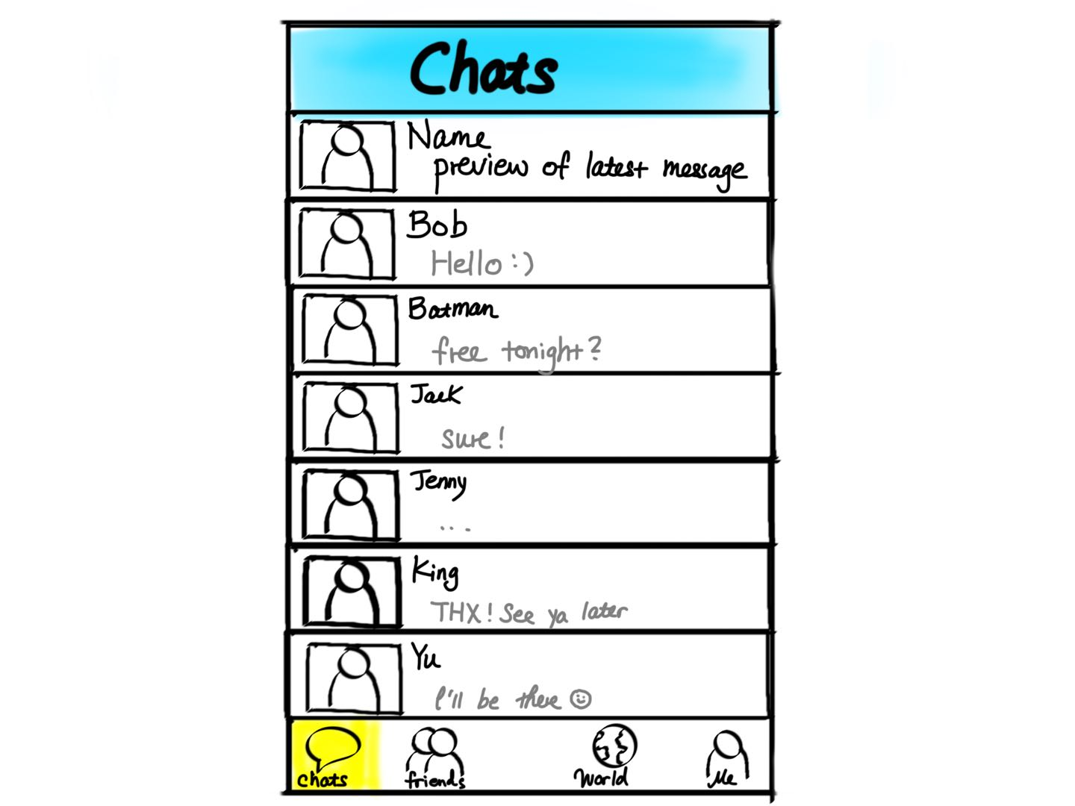

Slide 14
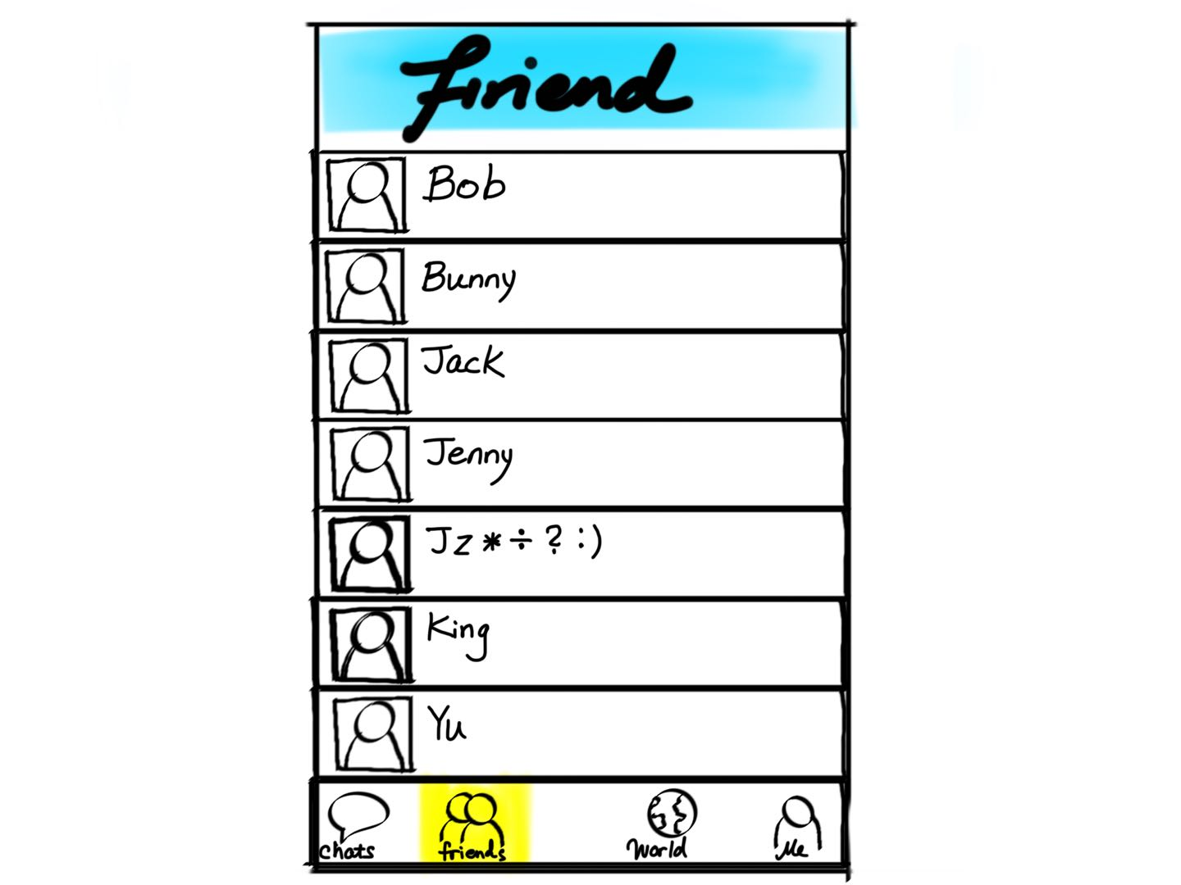

Slide 15
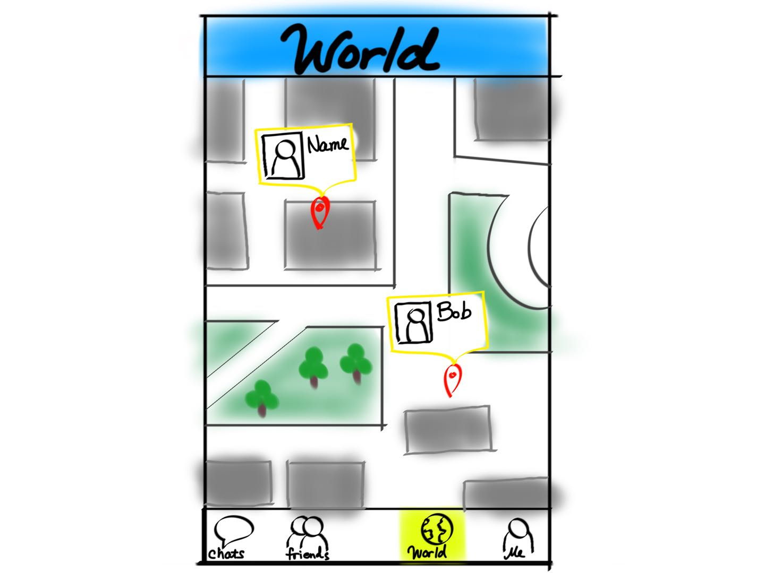

Slide 16
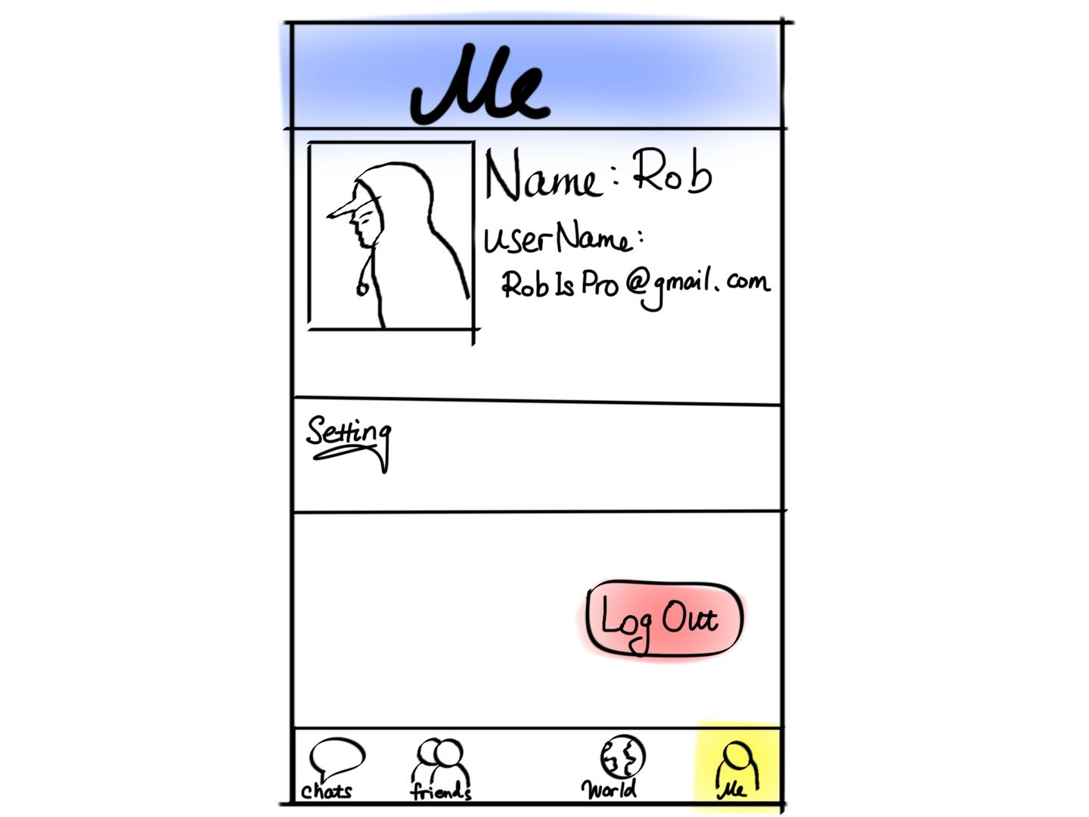

Slide 17
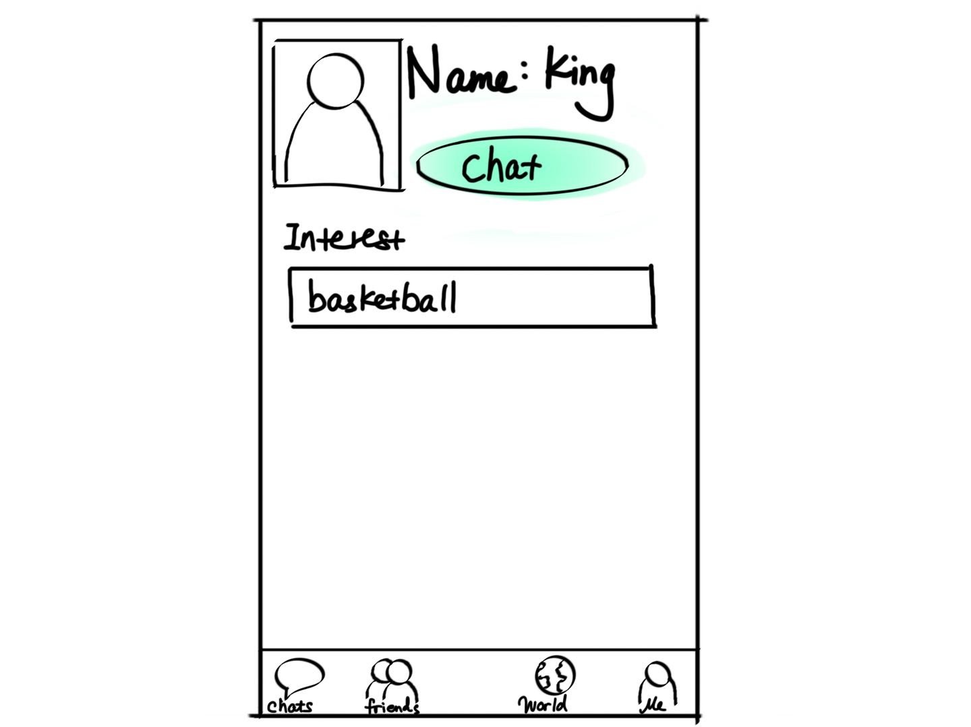

Slide 18
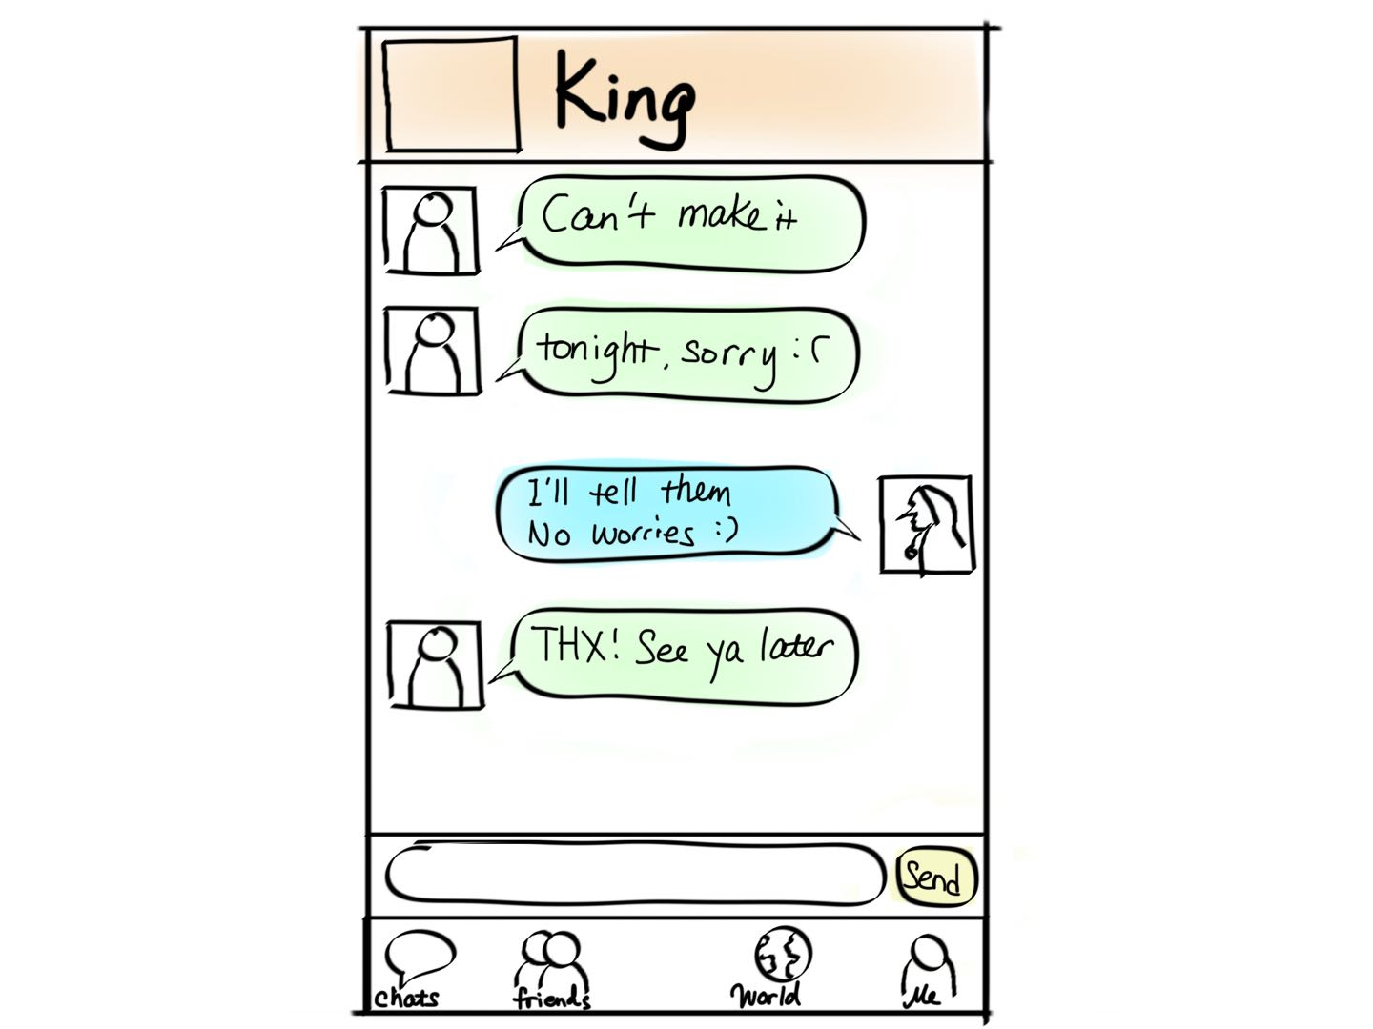

Slide 19
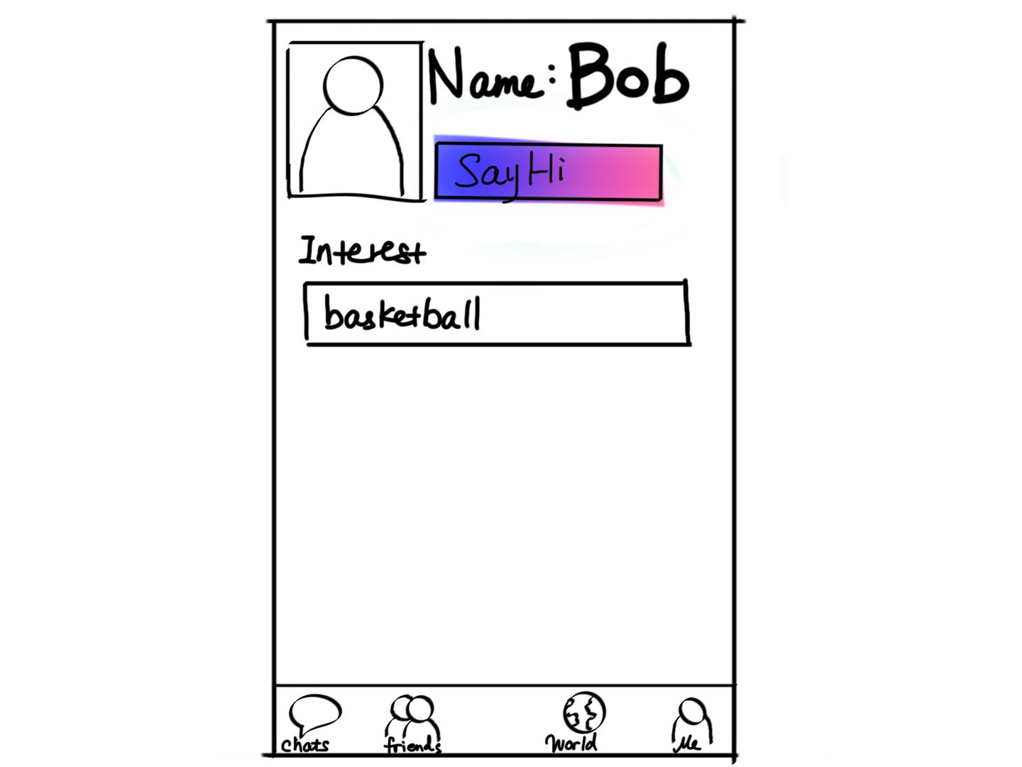

Slide 20
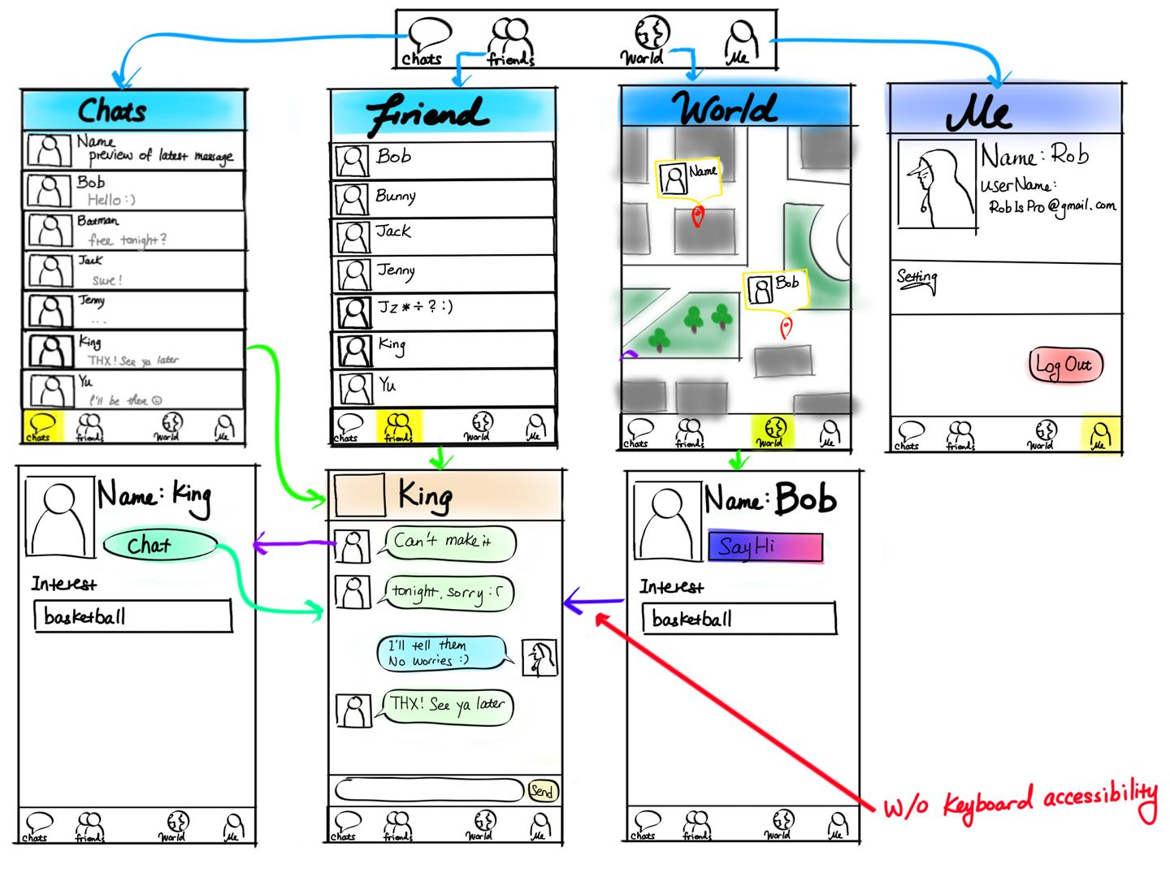

Slide 21


Thank you !!!

